Slide 1
Evidence in practice: Probiotics for preterm infants
Roger F. Soll, MD
H. Wallace Professor of Neonatology
Larner College of Medicine, University of Vermont
Coordinating Editor, Cochrane Neonatal
Vice President, Vermont Oxford Network
1

Slide 2
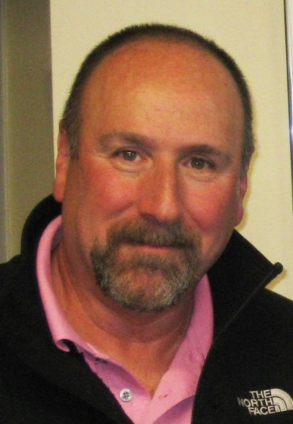



Editorial Team
Roger F. Soll
Coordinating Editor
Bill McGuire
Coordinating Editor
Colleen Ovelman
Managing Editor
Clare LaFrance
Program Coordinator

Slide 3
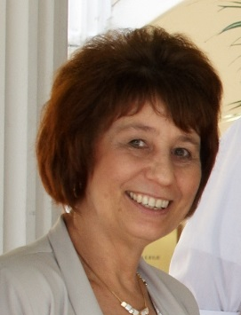
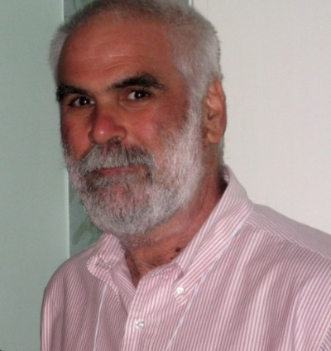



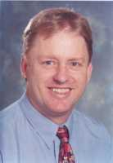
Editorial Team
Jackie Ho
RCSI & UCD Malaysia Campus
Jeffrey Horbar
University of Vermont
Prakeshkumar Shah
University of Toronto
Gautham Suresh
Baylor University
Lisa Askie
University of Sydney
David Osborn
University of Sydney

Slide 4
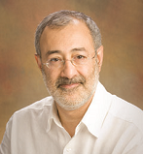


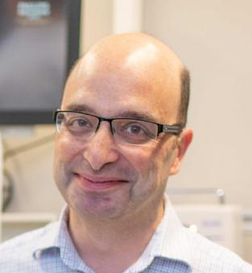














Associate Editors
4

Slide 5
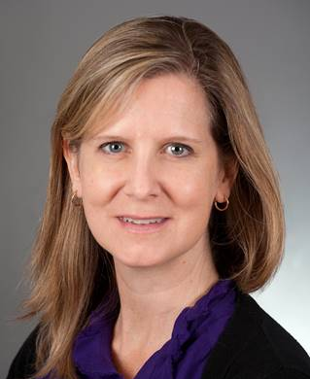
Guest Discussants
Danielle Ehret, MD, MPH
Associate Professor, University of Vermont
Director, Global Health, Vermont Oxford Network
Deirdre O'Reilly, MD, MPH
Associate Professor, University of Vermont
Director, NPM Fellowship, University of Vermont

Slide 6


Sponsors
Section on Neonatal-Perinatal Medicine

Slide 7
Probiotics for preterm infants
Roger F. Soll, M.D. is the Vice President
of the Vermont Oxford Network
and the Coordinating Editor
of Cochrane Neonatal
No other relevant financial issues to disclose

Slide 8
Probiotics for preterm infants
To develop an understanding of the strengths and weaknesses of evidence provided by systematic reviews and meta-analyses to inform our practice of neonatal-perinatal medicine.

Slide 9
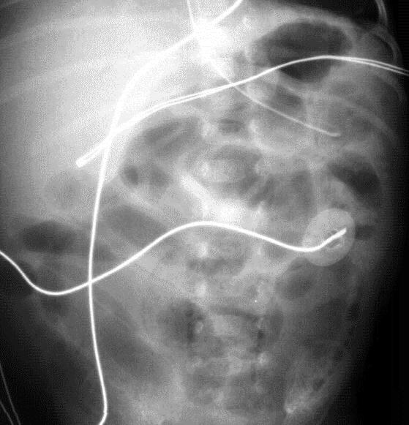
There is a real problem!

Slide 10
Necrotizing Enterocolitis (NEC)
Incidence
  1 to 5% of all NICU admissions
  6 to 7% of infants 500 to 1500 grams
  preterm > term
  black > white
  male > female (?)
Mortality
  12 to 30%
  surgical NEC: ~50%

Slide 11
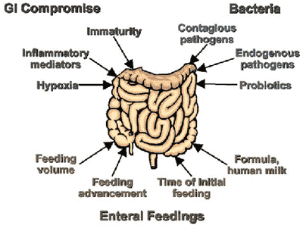
Necrotizing Enterocolitis

Slide 12
Soll’s Theorem
The number of arrows on a slide is inversely proportional to our understanding of the process

Slide 13
Necrotizing Enterocolitis (NEC)
Deterrence/Prevention
Breastfed babies have a lower incidence of NEC than formula-fed babies.
Unclear role of various feeding regimens in the etiology of NEC.
Although conventional wisdom recommends slow initiation
and advancement of enteral feeds for premature infants, randomized trials do not show an increased incidence of NEC for babies in whom feeds have been started earlier in life
or in whom feeding advancement has been more rapid.

Slide 14

What about probiotic supplementation?

Slide 15
Probiotics for preterm infants
There is a strong biological rationale!

Slide 16
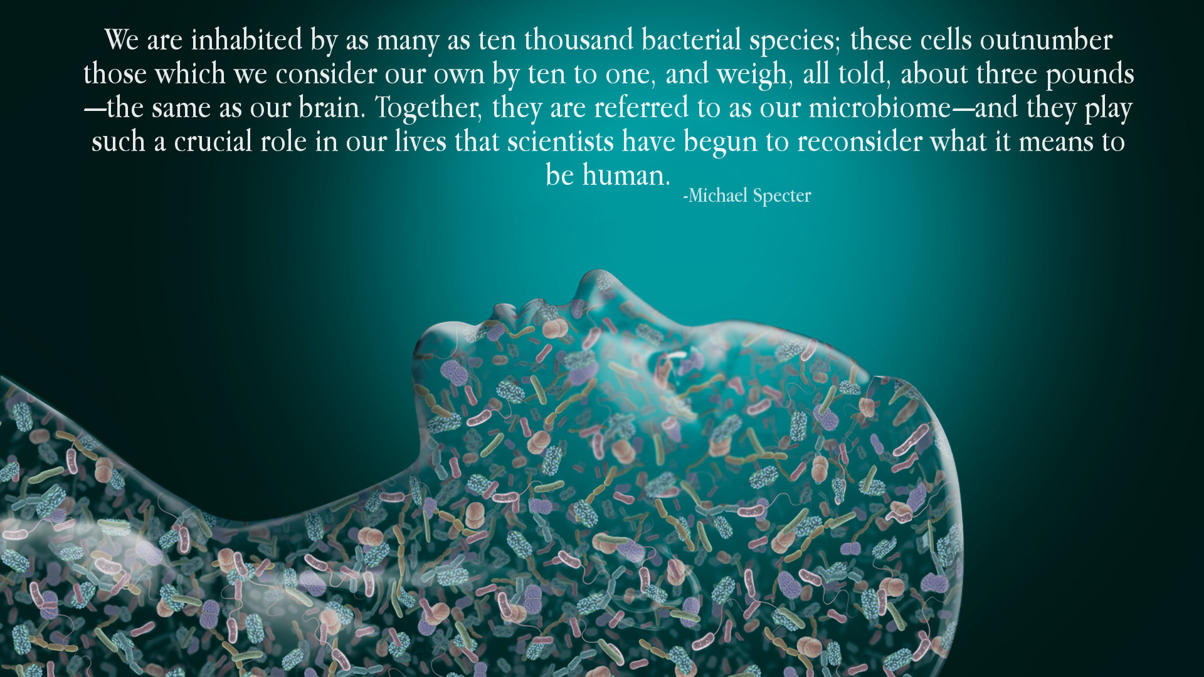
Probiotics for preterm infants

Slide 17
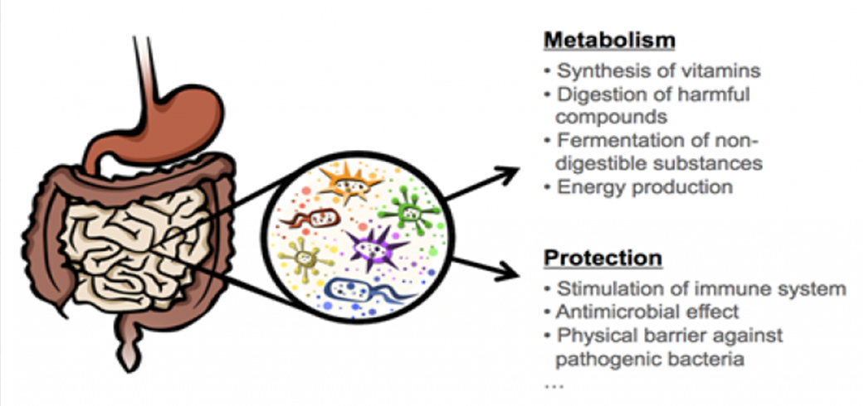
Functions of the microbiome
http://www.diapedia.org/type-1-diabetes-mellitus/microbiome-and-type-1-diabetes

Slide 18
Probiotics for preterm infants
At birth, the infant’s gastrointestinal tract (GI tract) is essentially “sterile”.
Colonization of the GI tract starts immediately after birth with the initiation of enteral feeding, and is well established within the first few days of life.
Intestinal flora varies widely from person to person. In adults, normal intestinal microflora consists of more than 100,000 billion bacterial cells comprising more than 400 different species.

Slide 19
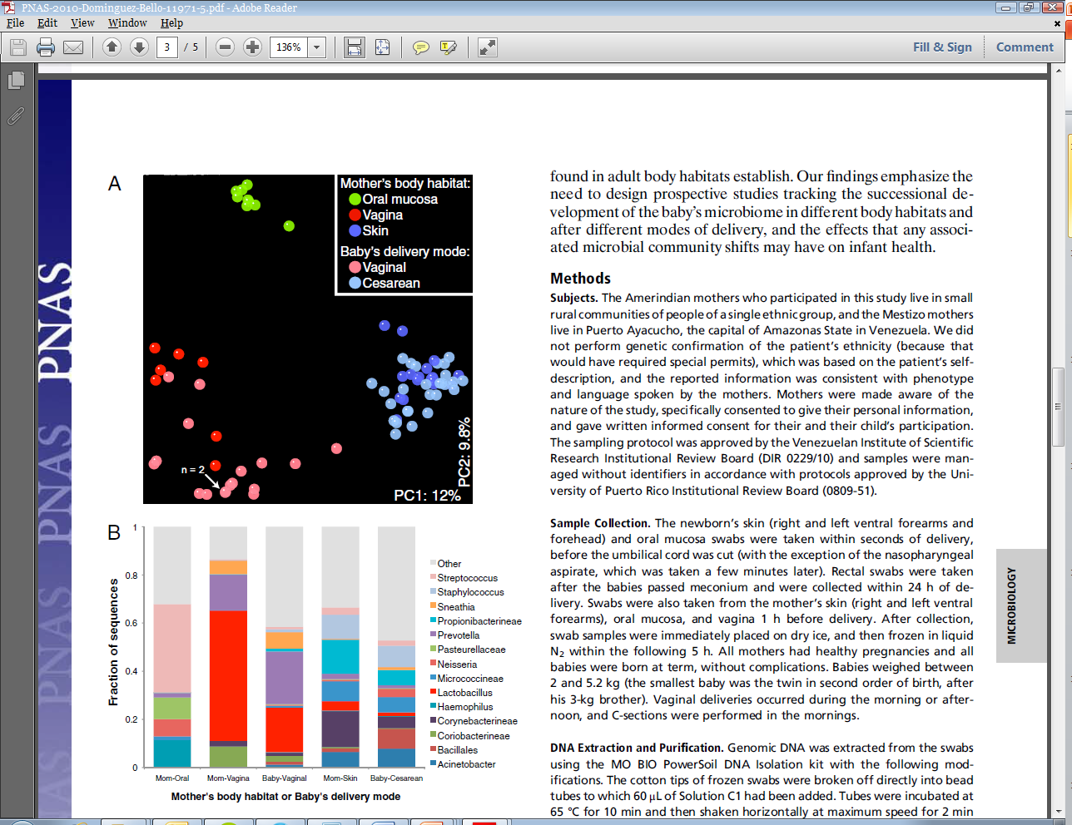
Development of the infant microbiome
Dominguez-Bello et al, PNAS 2010.

Slide 20
Probiotics for preterm infants
In formula-fed infants, coliforms, enterococci, and bacteroides predominantly colonize the intestinal tract. Bifidobacterium and Lactobacillus are present occasionally.
However, in breastfed infants, Bifidobacterium and Lactobacillus predominate with other enteric organisms being present less frequently.

Slide 21
Probiotics for preterm infants
This pattern of bowel colonization is different in preterm infant in an intensive care setting.
Antibiotic use, infection control procedures, and delayed initiation of enteral feeding may influence the type and amount of micro-organisms colonizing the GI tract.

Slide 22
Probiotics for preterm infants
The GI tract of ELBW infants are colonized by fewer than three bacterial species by the 10th day of life
Species of Bifidobacterium and Lactobacillus are found in the stool of less than 5% of patients studied within the 1st month of life
By day 30 of life, predominant organisms were enterobacteriaceae and coagulase-negative staphylococci, which are the most frequent pathogens responsible for nosocomial infection in the NICU.
Gewolb and colleagues. Arch Dis Child Fetal and Neonatal Ed. 1999

Slide 23
Probiotics for preterm infants
Probiotic bacteria are defined as live nonpathogenic bacteria species that normally reside in the GI tract of healthy term infants.
It has been postulated that introducing probiotics to preterm infants might be beneficial in order to avoid overgrowth of pathogenic organisms.
Probiotics supplementation has been proposed to enhance enteral feeding and prevent NEC and nosocomial infections in preterm infants.

Slide 24
Probiotics for preterm infants
The proposed beneficial effects of probiotic administration come from potentially competing with other organisms for binding sites and substrates in the bowel thereby:
increasing the production of anti-inflammatory cytokines,
decreasing the production of proinflammatory cytokines,
reducing intestinal permeability,
enhancing enteral nutrition.

Slide 25
Probiotics for preterm infants
Probiotics products are available in the United States without prescription as nutritional supplements.
A variety of probiotic agents may be available for study. Lactobacillus and Bifidobacterium species are available commercially in different forms and concentrations.

Slide 26
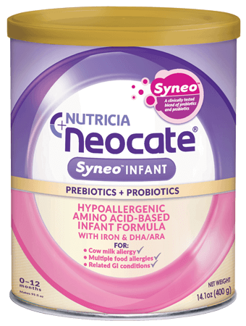
Probiotics for preterm infants
For good or for bad….
Infant formula with probiotic supplements has recently been marketed for sale to the general public….
Proprietary Formula

Slide 27
Probiotics for preterm infants
Does probiotic supplementation improve growth and feeding tolerance?

Slide 28
Probiotics for preterm infants
Kitajima 1997:
single center study randomized controlled trial
Intervention: 91 infants were randomized to receive enteral probiotics (Bifidobacterium breve) or control.

Slide 29
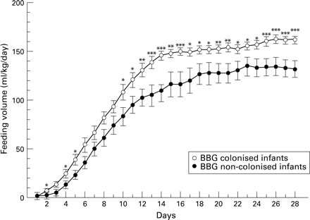
Probiotics for preterm infants
Kitajima, H. et al. Arch. Dis. Child. Fetal Neonatal Ed. 1997;76:101-F107

Slide 30
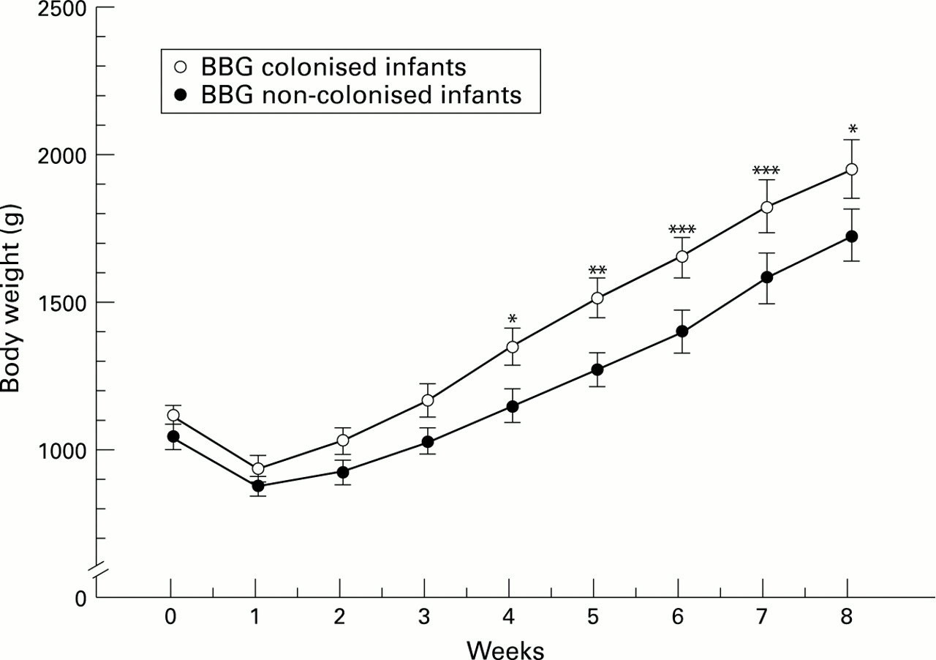
Probiotics for preterm infants
Kitajima, H. et al. Arch. Dis. Child. Fetal Neonatal Ed. 1997;76:101-F107

Slide 31
Probiotics for preterm infants
Does probiotic supplementation
improve clinical outcome?
        Infection
        Necrotizing Enterocolitis
        Mortality

Slide 32
Probiotics for prevention of
necrotizing enterocolitis in preterm infants
Khalid AlFaleh, Jasim Anabrees.
Cochrane Database of Systematic Reviews 2014

Slide 33
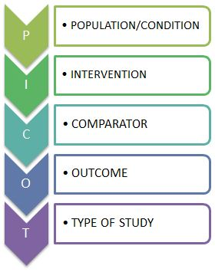
POPULATION OR CONDITION
In infants < 37 weeks gestation or < 2500 grams
does any enteral probiotic supplementation
compared to routine management of enteral feeds
improve morbidity and mortality
up to 18 to 24 months of age?
INTERVENTION
COMPARATOR
OUTCOME
TIME

Slide 34
Probiotics for prevention of
necrotizing enterocolitis in preterm infants
A total of 24 eligible trials that enrolled more than 5000 preterm infants were included in the meta-analysis

Slide 35
Probiotics to prevent necrotizing enterocolitis in very preterm infants.
Sharif S, Meader N, Oddie SJ, Rojas-Reyes MX, McGuire W.
Cochrane Database of Systematic Reviews 2020.
In preparation

Slide 36
POPULATION OR CONDITION
In very low birth weight or very preterm infants
does any enteral probiotic supplementation
compared to routine management of enteral feeds
improve morbidity and mortality
up to 18 to 24 months of age?
INTERVENTION
COMPARATOR
OUTCOME
TIME

Slide 37
Probiotics to prevent necrotizing enterocolitis in very preterm infants.
Includes 53 trials in which more than 10,000 very preterm infants participated.
The risk of bias varied with lack of clarity on methods to conceal allocation in half of the trials and lack of blinding of caregivers or investigators in all of the trials being the main potential sources of bias.
Variation in timing, dose, formulation of the probiotics, and feeding regimens.
Sharif and colleagues. Probiotics to prevent necrotising enterocolitis in very preterm infants. Cochrane Database of Systematic Reviews 2020. in preparation.

Slide 38


Slide 39
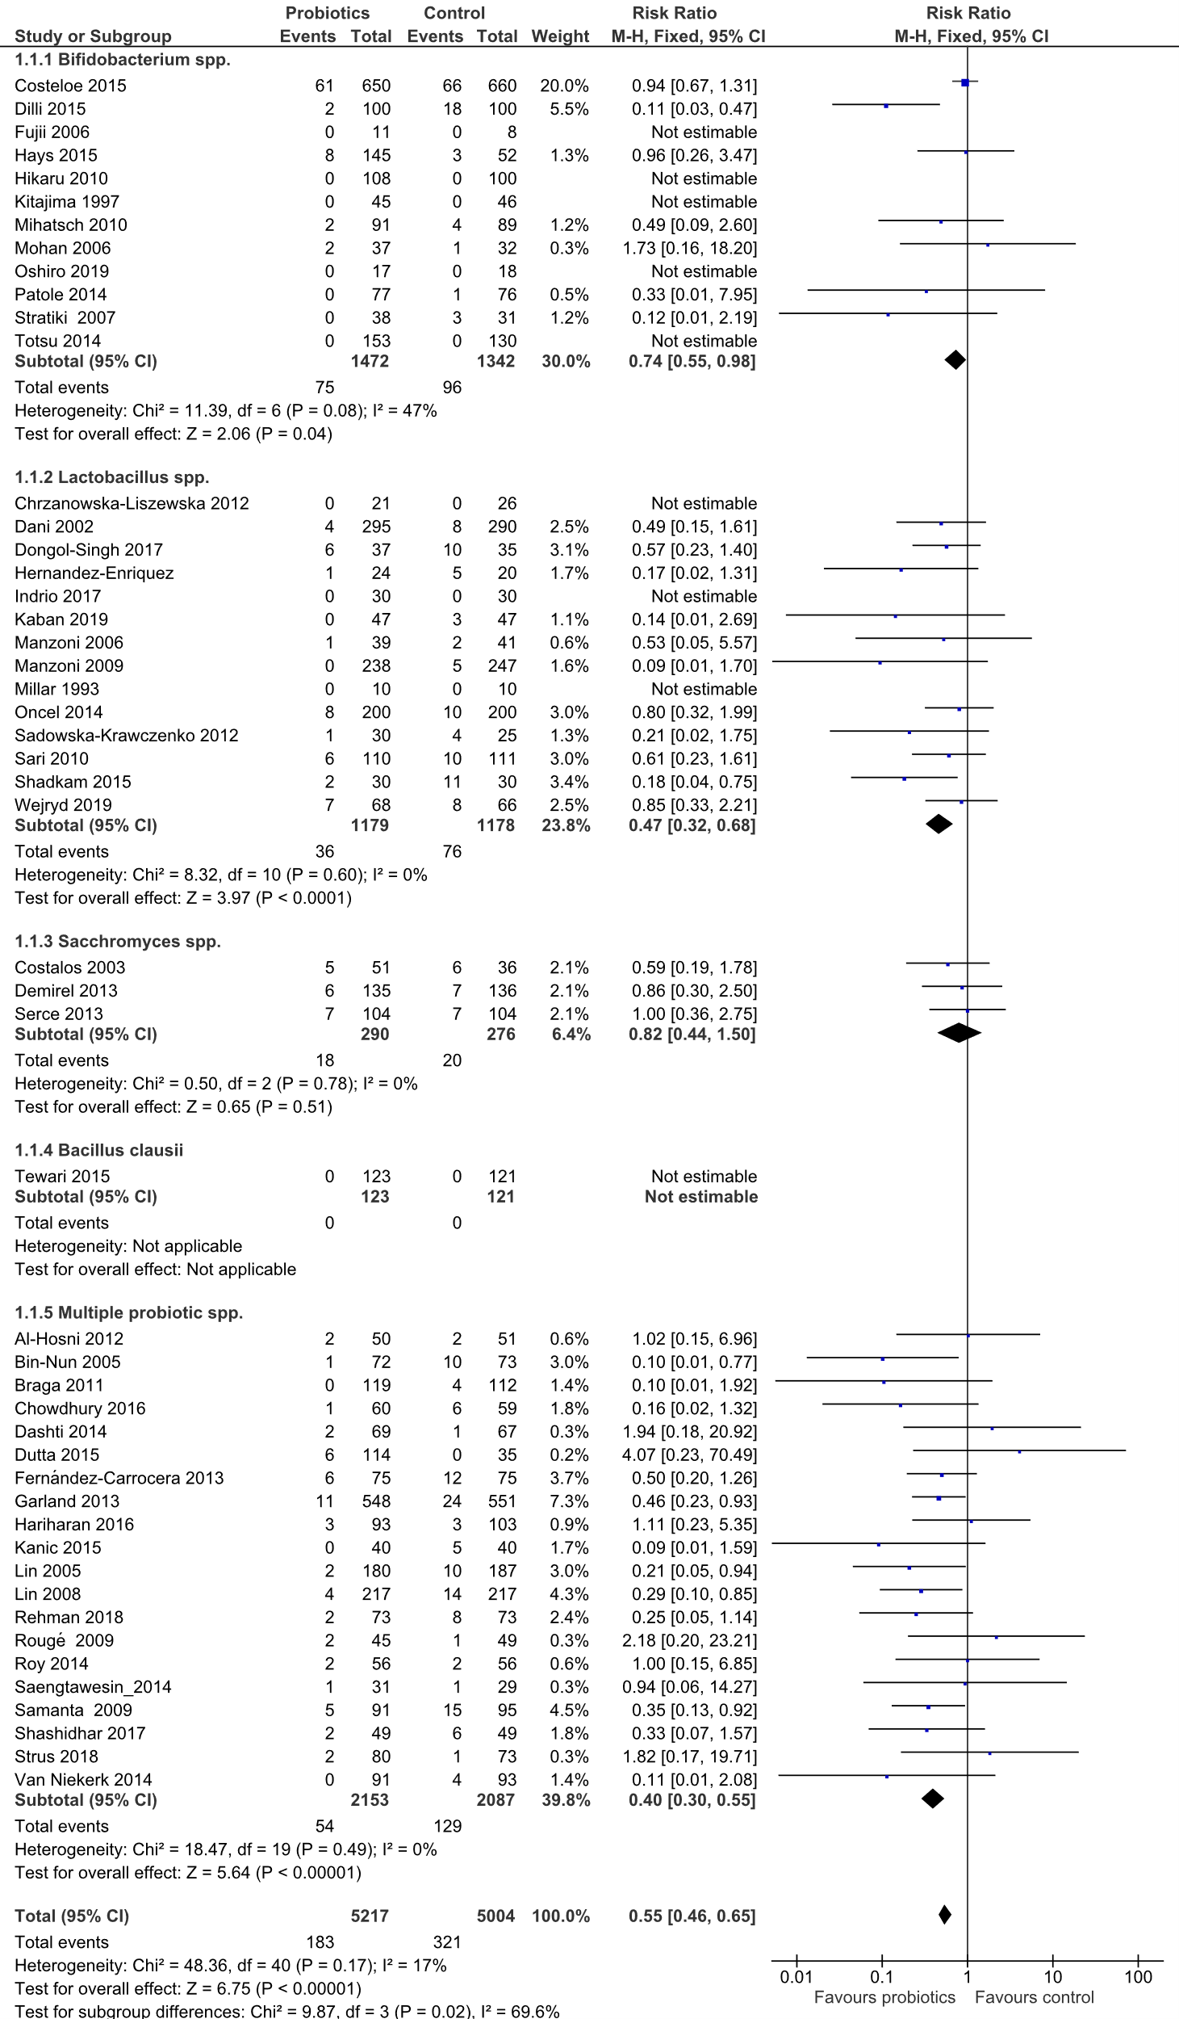

PROBIOTICS FOR THE PREVENTION OF NECROTIZING ENTEROCOLITIS IN PRETERM INFANTS:
EFFECT ON NECROTIZING ENTEROCOLITIS
W. McGuire

Slide 40
Probiotics to prevent necrotizing enterocolitis in very preterm infants.
Probiotic supplementation reduced:
Infection (45 trials, 9532 infants)
RR 0.88, 95% CI 0.80 to 0.95;
RD -0.02, 95% CI -0.04 to -0.01;
Number needed to treat for benefit (NNTB) 50, 95% CI 25 to 100
Necrotizing enterocolitis (52 trials,10306 infants)
RR 0.55, 95% CI 0.46 to 0.65;
RD -0.03, 95% CI -0.04 to -0.02;
Number needed to treat for benefit (NNTB) 33, 95% CI 25 to 50
Mortality (52 trials,10360 infants)
RR 0.75, 95% CI 0.64 to 0.87;
RD -0.02, 95% CI -0.03 to -0.01;
Number needed to treat for benefit (NNTB) 50, 95% CI 33 to 100.
Sharif and colleagues. Probiotics to prevent necrotising enterocolitis in very preterm infants. Cochrane Database of Systematic Reviews 2020. in preparation.

Slide 41
PROBIOTICS IN VERY PRETERM INFANTS
META-ANALYSIS OF 53 RANDOMIZED CONTROLLED TRIALS
Outcome (studies)
Relative risk
Decreased
Risk
Increased
( 95% CI )
0.2
0.5
1.0
2.0
4.0
INFECTION (45)
0.88 (0.80, 0.95)
NEC (52)
0.55 (0.46, 0.65)
MORTALITY (52)
0.75 (0.64, 0.88)
0.2
0.5
1.0
2.0
4.0
Relative Risk and 95% CI
Sharif and colleagues. Probiotics to prevent necrotising enterocolitis in very preterm infants. Cochrane Database of Systematic Reviews 2020. in preparation.

Slide 42
Probiotics for preterm infants
In the clinical trials, probiotic supplementation was not associated with any probiotic-related sepsis cases or any other adverse effects.

Slide 43
Probiotics for preterm infants
Current studies of probiotics:
Multiple agents
Multiple dosing strategies
Few extremely low birth weight infants
Few exclusively breast fed
No product that has cleared regulatory hurdles

Slide 44
PROBIOTIC SUPPLEMENTATION
NECROTZING ENTEROCOLITIS AND MORTALITY
Outcome
Relative Risk
Decreased
Risk
Increased
( 95% CI )
0.2
0.5
1.0
2.0
4.0
BIFIDOBACTERIA
- NECROTIZING ENTEROCOLITIS (12)
0.74 (0.55-0.98)
- MORTALITY (12)
0.79 (0.58-1.09)
LACTOBACILLUS + BIFIDOBACTERIA
- NECROTIZING ENTEROCOLITIS (20)
0.40 (0.30-0.55)
- MORTALITY (21)
0.68 (0.54-0.85)
LACTOBACILLUS
- NECROTIZING ENTEROCOLITIS (14)
0.47 (0.32-0.68)
- MORTALITY (14)
0.81 (0.56-1.17)
0.2
0.5
1.0
2.0
4.0
SHARIF 2020
Relative Risk and 95% CI

Slide 45
Probiotics for preterm infants
Network Analysis

Slide 46

Morgan RL, et al. Probiotics Reduce Mortality and Morbidity in Preterm, Low-Birth-Weight Infants: A Systematic Review and Network Meta-analysis of Randomized Trials.
Gastroenterology. 2020;159(2):467-80).
They found 63 trials which included a total of over 15,000 infants

Slide 47
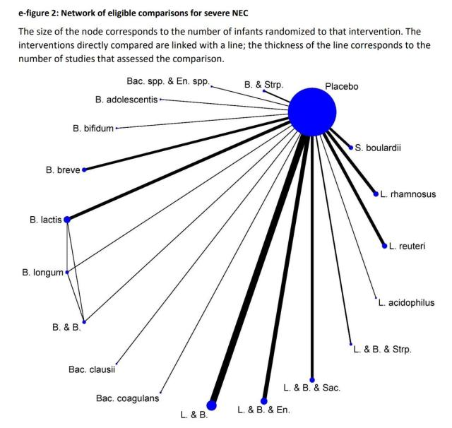
Network of Eligible Comparisons for Severe NEC

Slide 48
Probiotics for preterm infants
Compared with placebo, a combination of 1 or more Lactobacillus species and 1 or more Bifidobacterium species was the only intervention with moderate- or high-quality evidence of reduced mortality (odds ratio 0.56; 95% CI 0.39 to 0.80).
Among interventions with moderate- or high-quality evidence for efficacy compared with placebo, combinations of 1 or more Lactobacillus spp and 1 or more Bifidobacterium spp, significantly reduced severe NEC (odds ratio 0.35; 95% CI 0.20 to 0.59).
Unlike some other SRs with meta-analysis, they did not show a reduction in late-onset sepsis.
They also did not show any significant incidence of invasive infection with the probiotic organisms.

Slide 49
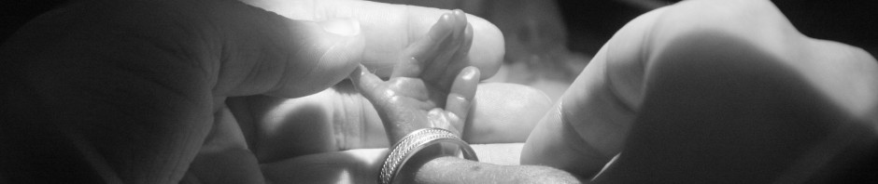
Probiotics for preterm infants
https://neonatalresearch.org/
“One thing I have difficulty understanding is the lack of clear guidance from either the American Academy of Pediatrics or the Canadian Paediatric Society regarding probiotic use in the preterm. Anything else that had been studied in 63 RCTs with over 15000 babies randomized showing a reduction in mortality, and a large reduction in serious NEC would surely by now have been the subject of a neonatal-specific position statement.”
Keith Barrington

Slide 50
Probiotics for preterm infants
What are We Worried About?

Slide 51
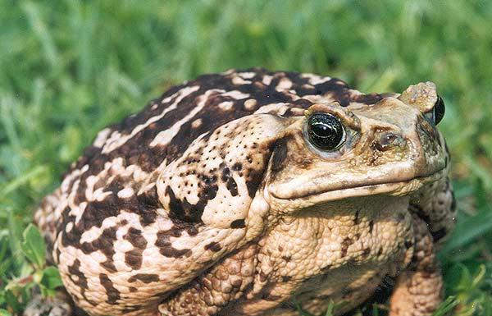
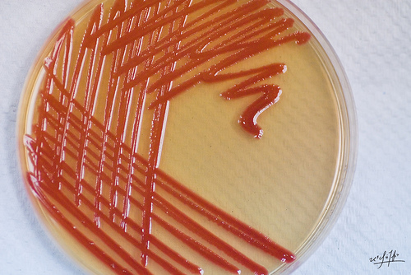
Probiotics for preterm infants
Cane toad
Serratia marcescens

Slide 52
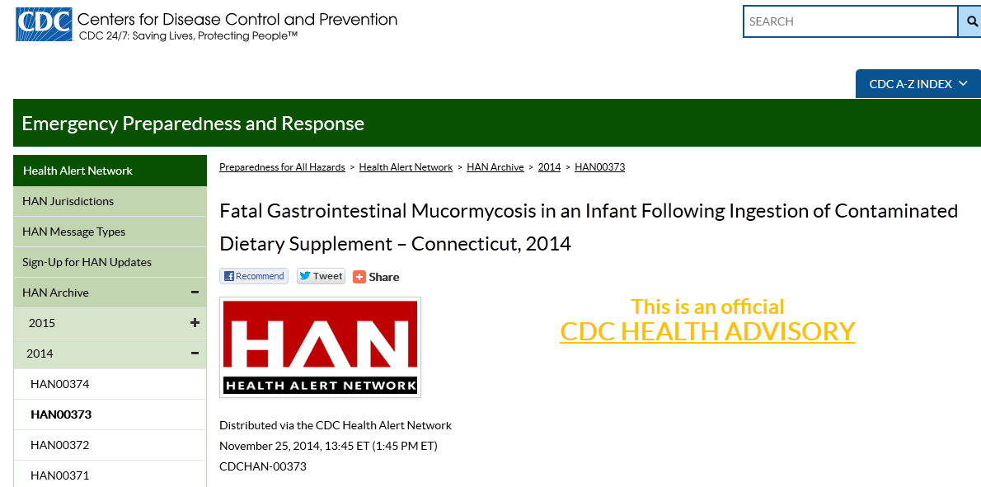
Houston…we have a problem!

Slide 53
Houston…we have a problem!
On November 22, 2014, FDA scientists confirmed the presence of Rhizopus oryzae from unopened containers of Solgar ABC Dophilus Powder, which had been collected at the hospital where the preterm infant died.
On December 9, 2014, the FDA alerted healthcare providers about the risks of using dietary supplements formulated to contain live bacteria or yeast in people with compromised immune systems.

Slide 54

Houston…we have a problem!

Slide 55
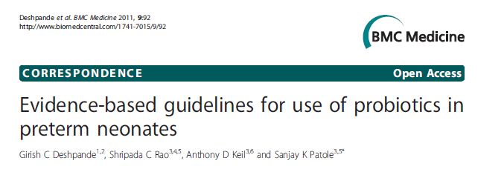
Do we have a solution?

Slide 56
Do we have a solution?
“It would be reasonable to use probiotic products that have previously been shown to be effective in RCTs, provided the evidence indicates that there has been no change or compromise in the manufacturing technique”
“On-site expert microbiological support is vital for independent taxonomy confirmation, exclusion of contaminants and confirmation of colony counts in the reconstituted product”
“The need for post-marketing surveillance has been emphasized by expert committees”
Deshpande and colleagues. BMC Medicine 2011

Slide 57
Probiotics in VLBW Infants
VERMONT OXFORD NETWORK ANNUAL REPORTS 2012-2017

Slide 58
PROBIOTIC USE:
WHAT DO PARENTS THINK?
Information sheet helpful
Worried about use of live bacteria
Worried about unknown risks
Right to be informed
Given information and option
79%
10%
12%
96%
64%
Sesham and colleagues. Arch Dis Child Fetal Neonatal 2014

Slide 59
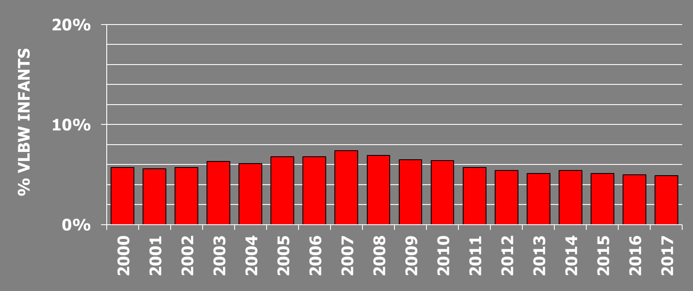
Necrotizing Enterocolitis in VLBW Infants
VERMONT OXFORD NETWORK ANNUAL REPORTS 2000-2017

Slide 60
Probiotics for preterm infants
Probiotic supplementation decreases the risk of necrotizing enterocolitis and improves survival.
Which product?
Need for further regulatory approval?
What is the role of families/parents
in furthering this research agenda?
In approving use in their baby?

Slide 61

What to actually do?

Slide 62


Slide 63
What do we know about…
Benefits and Harms
Desirable Effects: How substantial are the desirable anticipated effects?
Undesirable Effects: How substantial are the undesirable anticipated effects?
Certainty of evidence: What is the overall certainty of the evidence of effects?

Slide 64
What do we know about…
Outcome importance: Is there important uncertainty about or variability in how much people value the main outcomes?

Slide 65
What do we know about…
Balance of effects: Does the balance between desirable and undesirable effects favor the intervention or the comparison?
Notes:
Fig 1 Hierarchy of outcomes according to importance to patients to assess effect of phosphate lowering drugs in patients with renal failure and hyperphosphataemia

Slide 66
What do we know about…
Acceptability: Is the intervention acceptable to key stakeholders?

Slide 67

Guest Discussants
Danielle Ehret, MD, MPH
Associate Professor, University of Vermont
Director, Global Health, Vermont Oxford Network
William McGuire
Professor of Child Health
Centre for Reviews and Dissemination,
University of York, York, UK

Slide 68
Evidence in practice: Probiotics for preterm infants
Roger F. Soll, MD
H. Wallace Professor of Neonatology
Larner College of Medicine, University of Vermont
Coordinating Editor, Cochrane Neonatal
Vice President, Vermont Oxford Network
1

Slide 69

Title of Program: Evidence in practice: Probiotics for preterm infants
Speakers/Moderators: Roger F. Soll, Danielle Ehret, William McGuire
Planning Committee: Jeffery D. Horbar, Roger F. Soll, Denise Zayack
Date: September 23, 2020
Learning Objectives:
The goal of the web seminar series is to identify and demonstrate an understanding of the underlying principles of evidence-based medicine (EBM), and to translate this understanding into clinical decision scenarios.
The goal of this session is for participants to be able to evaluate neonatal evidence presented via clinical trials and systematic reviews regarding the use of probiotics for preterm infants to better serve their practice and be able to translate neonatal evidence presented via clinical trials and systematic reviews to better serve their practice.
DISCLOSURE:
Is there anything to disclose? No financial interests to disclose
COMMERCIAL SUPPORT ORGANIZATIONS (if applicable): No Commercial Support
In support of improving patient care, this activity has been planned and implemented by The Robert Larner College of Medicine at The University of Vermont and Cochrane Neonatal. The University of Vermont is jointly accredited by the Accreditation Council for Continuing Medical Education (ACCME), the Accreditation Council for Pharmacy Education (ACPE), and the American Nurses Credentialing Center (ANCC), to provide continuing education for the healthcare team.
The University of Vermont designates this internet live activity for a maximum of 1 AMA PRA Category 1 Credit(s)™. Physicians should claim only the credit commensurate with the extent of their participation in the activity. This program has been reviewed and is acceptable for up to 1 Nursing Contact Hour.

Slide 70



Slide 71
Guest Discussants
Danielle Ehret, MD, MPH
Associate Professor, University of Vermont
Director, Global Health, Vermont Oxford Network
William McGuire
Professor of Child Health
Centre for Reviews and Dissemination,
University of York, York, UK

Slide 72
Sponsors
Section on Neonatal-Perinatal Medicine

Slide 73
Probiotics for preterm infants
Roger F. Soll, M.D. is the Vice President
of the Vermont Oxford Network
and the Coordinating Editor
of Cochrane Neonatal
No other relevant financial issues to disclose

Slide 74

How to Participate in Today’s Webinar
Type questions you have into the chat box at anytime during the presentation.
Use Poll Everywhere to answer questions posed during the session.

Slide 75



Three ways to use Poll Everywhere
*
Open your web browser and type in pollev.com/vtoxford
Download the app Poll Everywhere on your phone. After it is installed open and select Join Presentation and type in vtoxford
Pollev.com/vtoxford
Text vtoxford to 22333
22333
vtoxford +
your response
Web voting
Text voting
Notes:
General use graphics to be customized according to your poll’s instructions

Slide 76

Have you ever participated in a
Cochrane Neonatal Web Seminar?
Have you ever participated in a Cochrane Neonatal Web Seminar?
Yes
No
I can’t remember

Slide 77
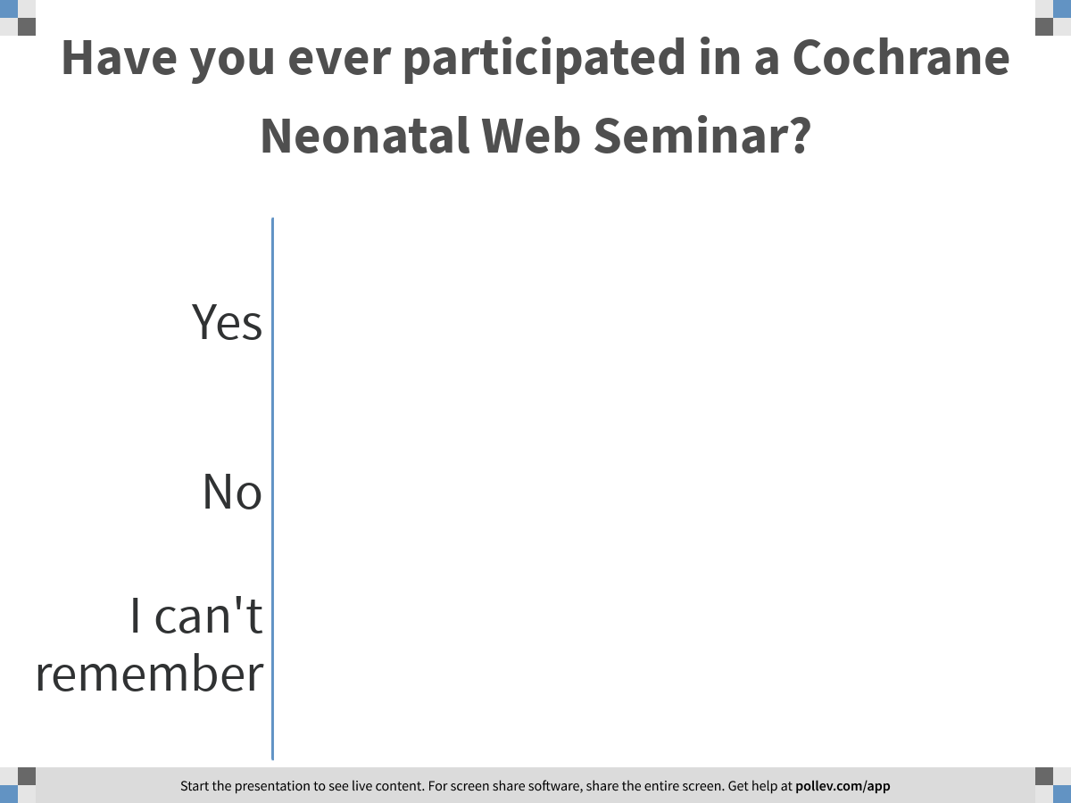
Notes:
Poll Title: Have you ever participated in a Cochrane Neonatal Web Seminar?
https://www.polleverywhere.com/multiple_choice_polls/QvTYebKhRIVfbWXiAsdP8?flow=Default&onscreen=persist

Slide 78
What about probiotic supplementation?

Slide 79
What to actually do?

Slide 80
What do we know about…
Benefits and Harms
Desirable Effects: How substantial are the desirable anticipated effects?
Undesirable Effects: How substantial are the undesirable anticipated effects?

Slide 81
Probiotics for preterm infants
Trials of probiotic supplementation in preterm infants report an overall decrease in adverse neurological outcome and mortality.
• Yes
• No
• Uncertain

Slide 82
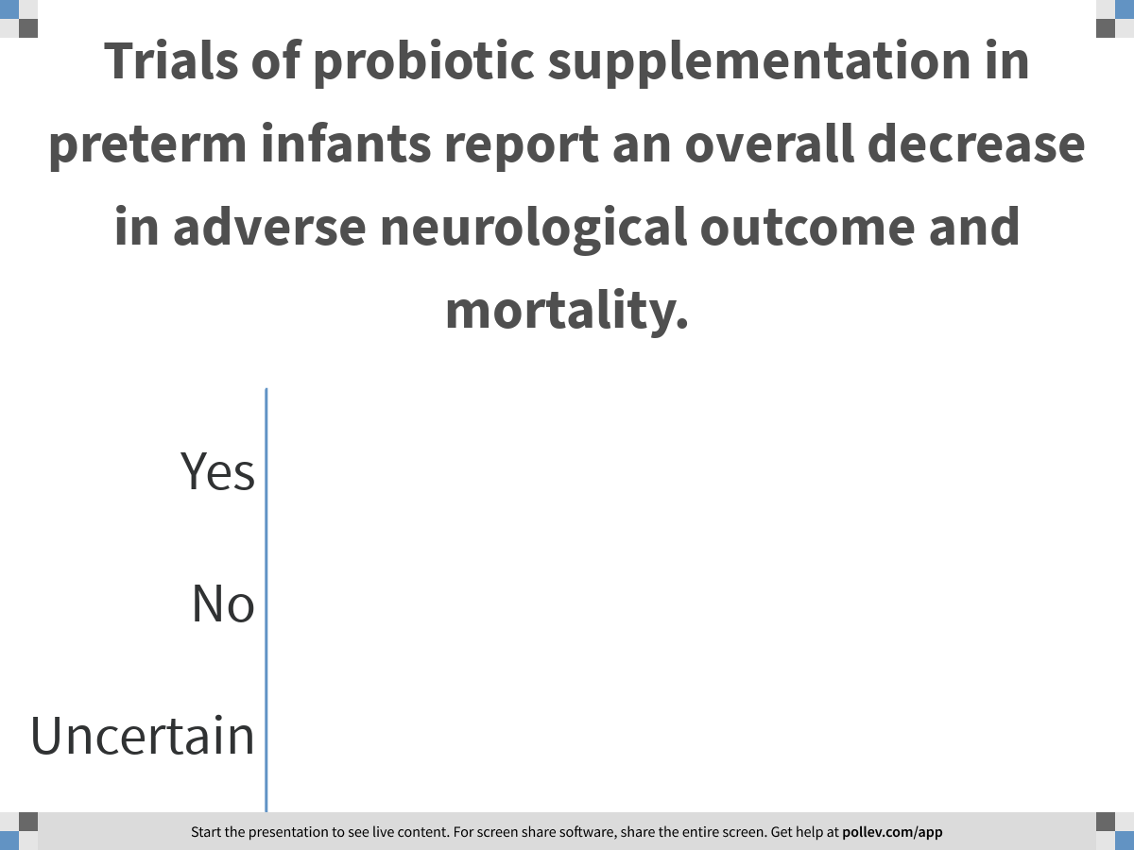
Notes:
Poll Title: Trials of probiotic supplementation in preterm infants report an overall decrease in adverse neurological outcome and mortality.
https://www.polleverywhere.com/multiple_choice_polls/eNNDbwYfS2c7zO5rqaMBf

Slide 83

Probiotics to prevent necrotizing enterocolitis in very preterm infants.
Sharif S, Meader N, Oddie SJ, Rojas-Reyes MX, McGuire W.
Cochrane Database of Systematic Reviews 2020.
In preparation

Slide 85
Probiotics to prevent necrotizing enterocolitis in very preterm infants.
Includes 53 trials in which more than 10,000 very preterm infants participated.
The risk of bias varied with lack of clarity on methods to conceal allocation in half of the trials and lack of blinding of caregivers or investigators in all of the trials being the main potential sources of bias.
Variation in timing, dose, formulation of the probiotics, and feeding regimens.
Sharif and colleagues. Probiotics to prevent necrotising enterocolitis in very preterm infants. Cochrane Database of Systematic Reviews 2020. in preparation.

Slide 86
Probiotics to prevent necrotizing enterocolitis in very preterm infants.
The effect of probiotic supplementation:
Infection (45 trials, 9532 infants)
RR 0.88, 95% CI 0.80 to 0.95; *
RD -0.02, 95% CI -0.04 to -0.01; *
Necrotizing enterocolitis (52 trials,10306 infants)
RR 0.55, 95% CI 0.46 to 0.65; *
RD -0.03, 95% CI -0.04 to -0.02; *
Adverse neurodevelopmental outcome (5 trials, 1518 infants)
RR 1.03, 95% CI 0.84 to 1.26;
RD 0.01, 95% CI -0.03 to 0.05;
Mortality (52 trials,10360 infants)
RR 0.75, 95% CI 0.64 to 0.87; *
RD -0.02, 95% CI -0.03 to -0.01 *
Sharif and colleagues. Probiotics to prevent necrotising enterocolitis in very preterm infants. Cochrane Database of Systematic Reviews 2020. in preparation.

Slide 87
Probiotics for preterm infants
Trials of probiotic supplementation in extremely low birth weight infants report overall decreases in necrotizing enterocolitis and mortality.
Yes
No
Uncertain

Slide 88
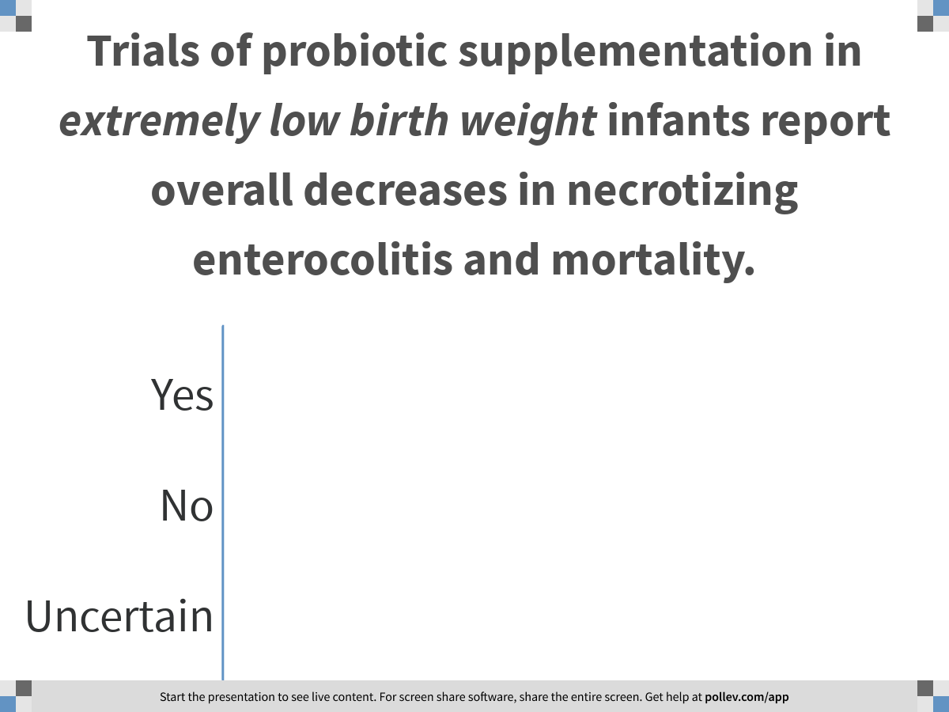
Notes:
Poll Title: Trials of probiotic supplementation in extremely low birth weight infants report overall decreases in necrotizing enterocolitis and mortality.
https://www.polleverywhere.com/multiple_choice_polls/oZSyTzEGeQ4uD0T5MCRuS

Slide 89
EXTREMELY PRETERM OR ELBW INFANTS
NECROTIZING ENTEROCOLITIS AND MORTALITY
Outcome (number of studies)
Relative Risk
Decreased
Risk
Increased
( 95% CI )
0.2
0.5
1.0
2.0
4.0
BIFIDOBACTERIA
- NECROTIZING ENTEROCOLITIS (2)
1.00 (0.70, 1.43)
- MORTALITY (1)
0.94 (0.65, 1.35)
LACTOBACILLUS
- NECROTIZING ENTEROCOLITIS (2)
0.73 (0.36, 1.48)
- MORTALITY (2)
0.78 (0.42, 1.42)
LACTOBACILLUS + BIFIDOBACTERIA + others
- NECROTIZING ENTEROCOLITIS (4)
0.78 (0.38, 1.57)
- MORTALITY (3)
0.93 (0.62, 1.41)
0.2
0.5
1.0
2.0
4.0
SHARIF 2020
Relative Risk and 95% CI

Slide 90
What do we know about…
Certainty of evidence: What is the overall certainty of the evidence of effects?
What issues that might influence “downGRADEing” of the evidence?

Slide 91

Five factors that can lower quality
Limitations of design and execution (risk of bias)
Inconsistency (heterogeneity)
Indirectness (patient population and applicability)
Imprecision (limitations in sample size, confidence intervals)
Publication bias

Slide 92
Probiotics for preterm infants
The certainty of the evidence provided by the randomized controlled trials of probiotics is:
High
Moderate
Low
Very low

Slide 93
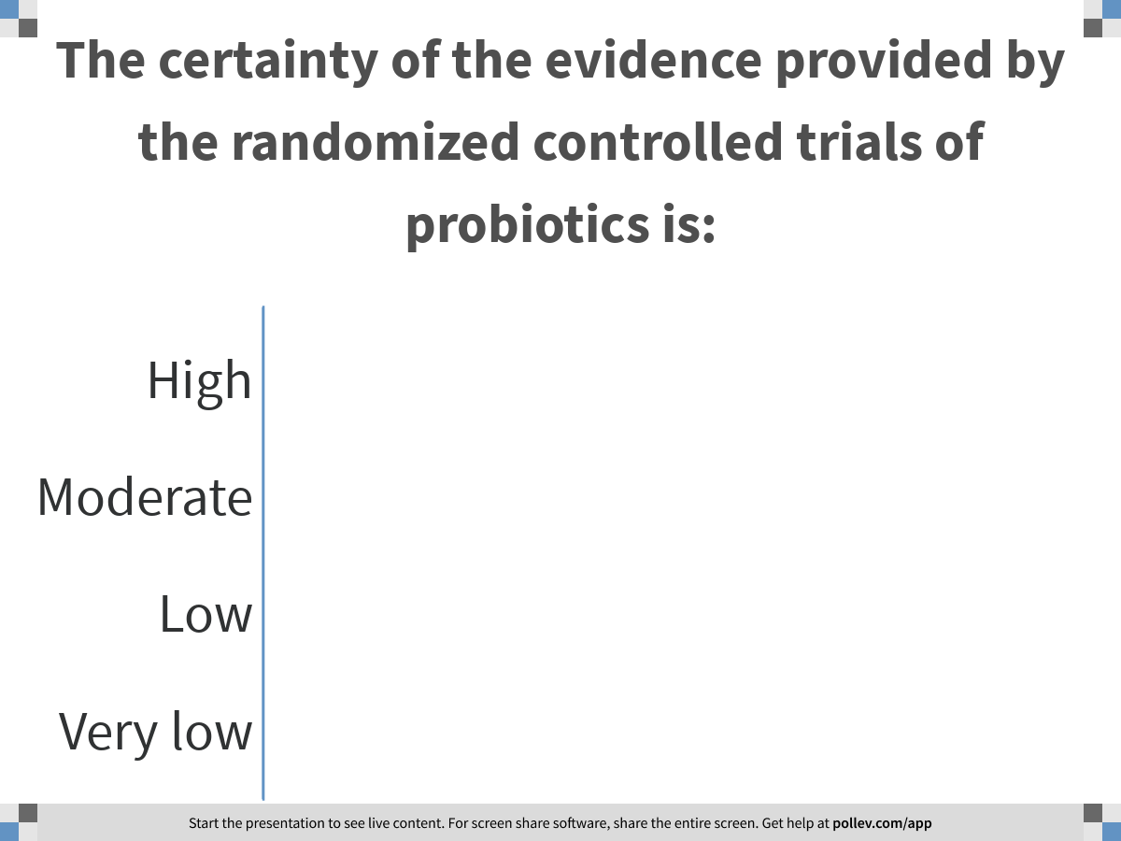
Notes:
Poll Title: The certainty of the evidence provided by the randomized controlled trials of probiotics is:
https://www.polleverywhere.com/multiple_choice_polls/YscaAeNdyfJDhWq8a0BBu

Slide 94
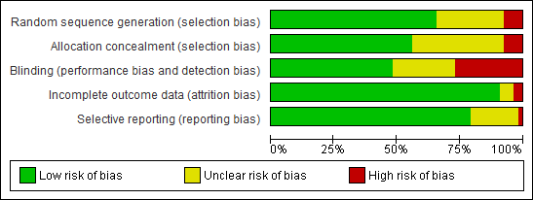
Probiotics for preterm infants
Median sample size= 149 infants
Two trials > 1000 participants

Slide 95
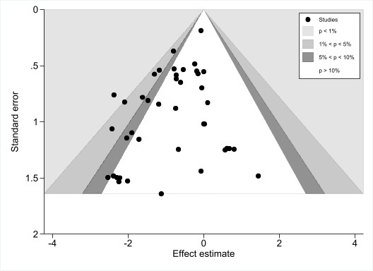
The “funnel plot”
Necrotizing enterocolitis

Slide 96
Probiotics for preterm infants
The preferred probiotic intervention is known.
Yes
No
Uncertain

Slide 97
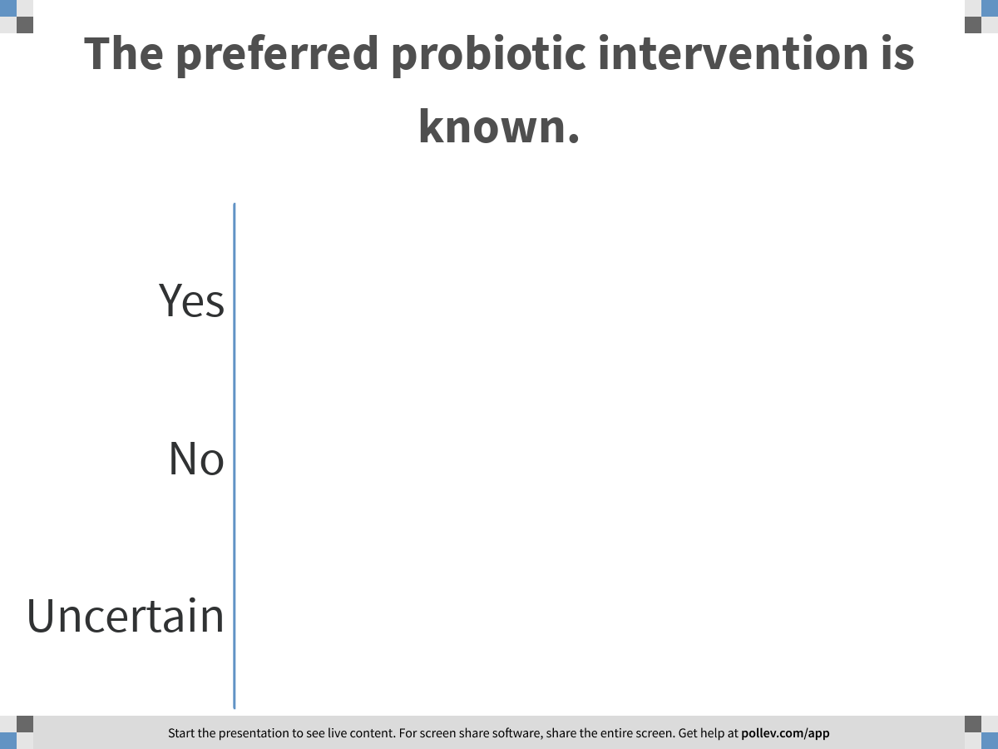
Notes:
Poll Title: The preferred probiotic intervention is known.
https://www.polleverywhere.com/multiple_choice_polls/ovQS5N1CgugtwS9AiTB4L

Slide 98
PROBIOTIC SUPPLEMENTATION
NECROTZING ENTEROCOLITIS AND MORTALITY
Outcome (number of studies)
Relative Risk
Decreased
Risk
Increased
( 95% CI )
0.2
0.5
1.0
2.0
4.0
BIFIDOBACTERIA
- NECROTIZING ENTEROCOLITIS (12)
0.74 (0.55-0.98)
- MORTALITY (12)
0.79 (0.58-1.09)
LACTOBACILLUS + BIFIDOBACTERIA + others
- NECROTIZING ENTEROCOLITIS (20)
0.40 (0.30-0.55)
- MORTALITY (21)
0.68 (0.54-0.85)
LACTOBACILLUS
- NECROTIZING ENTEROCOLITIS (14)
0.47 (0.32-0.68)
- MORTALITY (14)
0.81 (0.56-1.17)
0.2
0.5
1.0
2.0
4.0
SHARIF 2020
Relative Risk and 95% CI

Slide 99
Probiotics for preterm infants
Probiotic agents are on our hospital formulary (and therefore theoretically available for use):
Yes
No
Uncertain

Slide 100
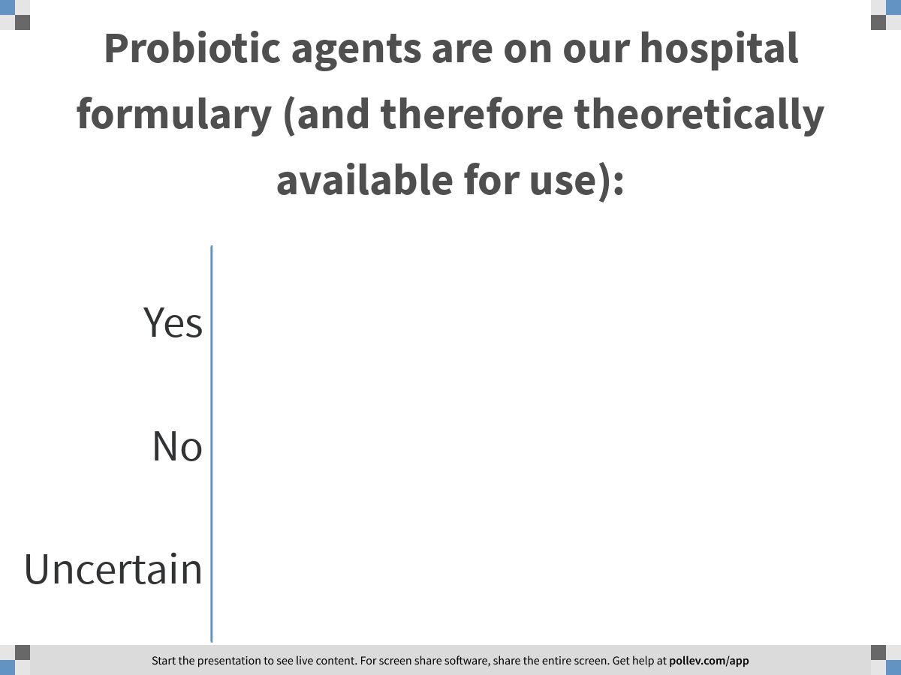
Notes:
Poll Title: Probiotic agents are on our hospital formulary (and therefore theoretically available for use):
https://www.polleverywhere.com/multiple_choice_polls/yL24xzJCFB43CkARkzSwn

Slide 101
Probiotics for preterm infants
In our unit, probiotics are used in very low birth weight preterm infants:
Routinely
Occasionally
Never

Slide 102
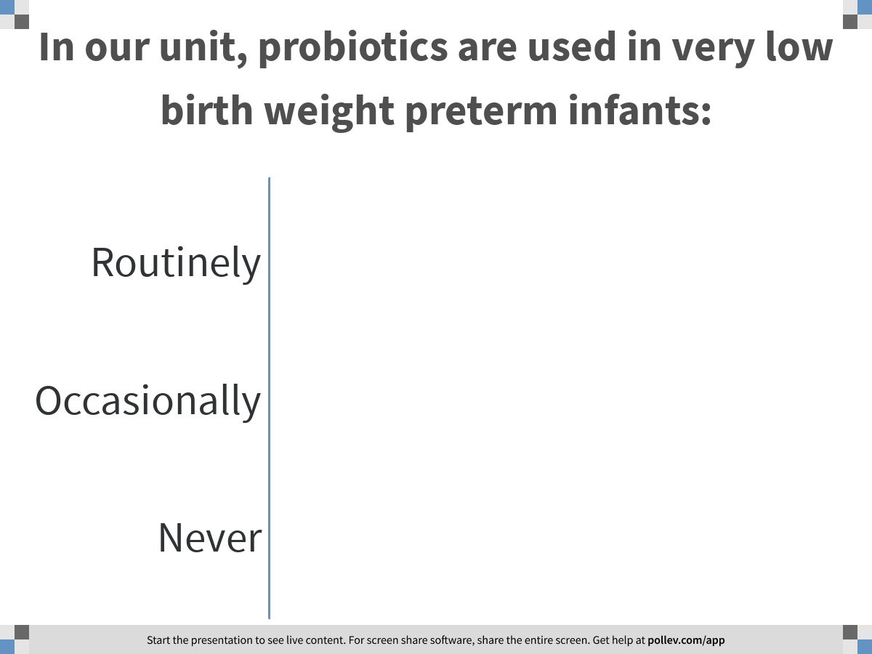
Notes:
Poll Title: In our unit, probiotics are used in very low birth weight preterm infants:
https://www.polleverywhere.com/multiple_choice_polls/YXVs3tnEVn29K19ROrnSu

Slide 103
Probiotics in VLBW Infants
VERMONT OXFORD NETWORK ANNUAL REPORTS 2012-2017

Slide 104
Probiotics for preterm infants
What do you think the main barrier is to adopting the routine use of probiotics?
• There is insufficient evidence of any effect
• The risks of probiotic supplementation outweigh the benefits
• There is insufficient evidence regarding the appropriate product
• There is no approved product available
• No perceived barrier, we use probiotics

Slide 105
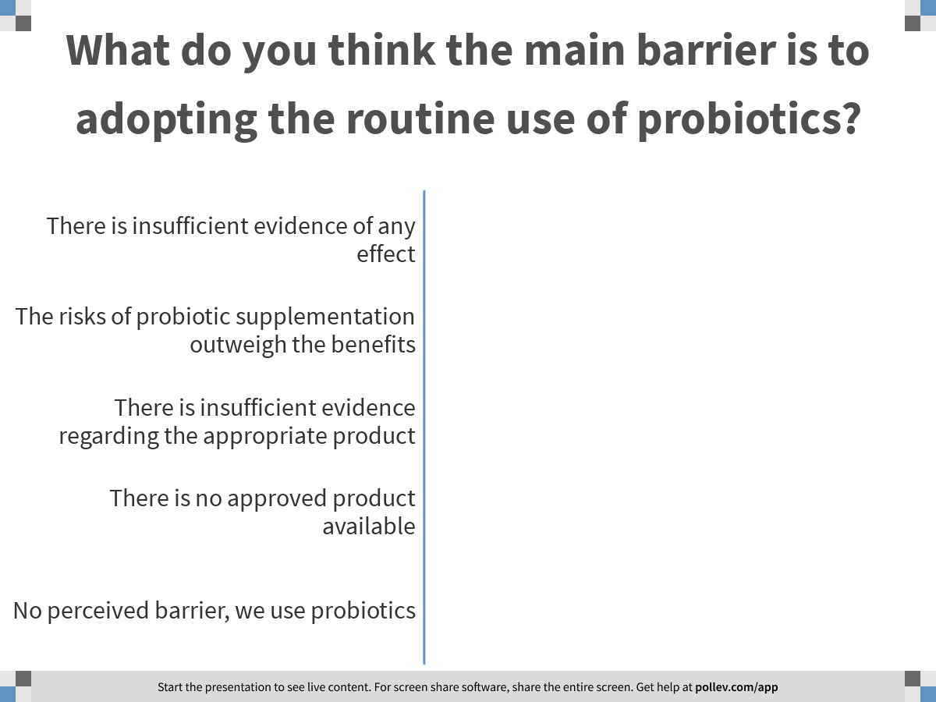
Notes:
Poll Title: What do you think the main barrier is to adopting the routine use of probiotics?
https://www.polleverywhere.com/multiple_choice_polls/DjPUwNeCCNXHXoDP4aGaa

Slide 106
What do we know about…
Acceptability: Is the intervention acceptable to key stakeholders?

Slide 107
Probiotics for preterm infants
Do you think that parents should be involved in the decision regarding the use of probiotics in their baby?
Yes
No
Uncertain

Slide 108
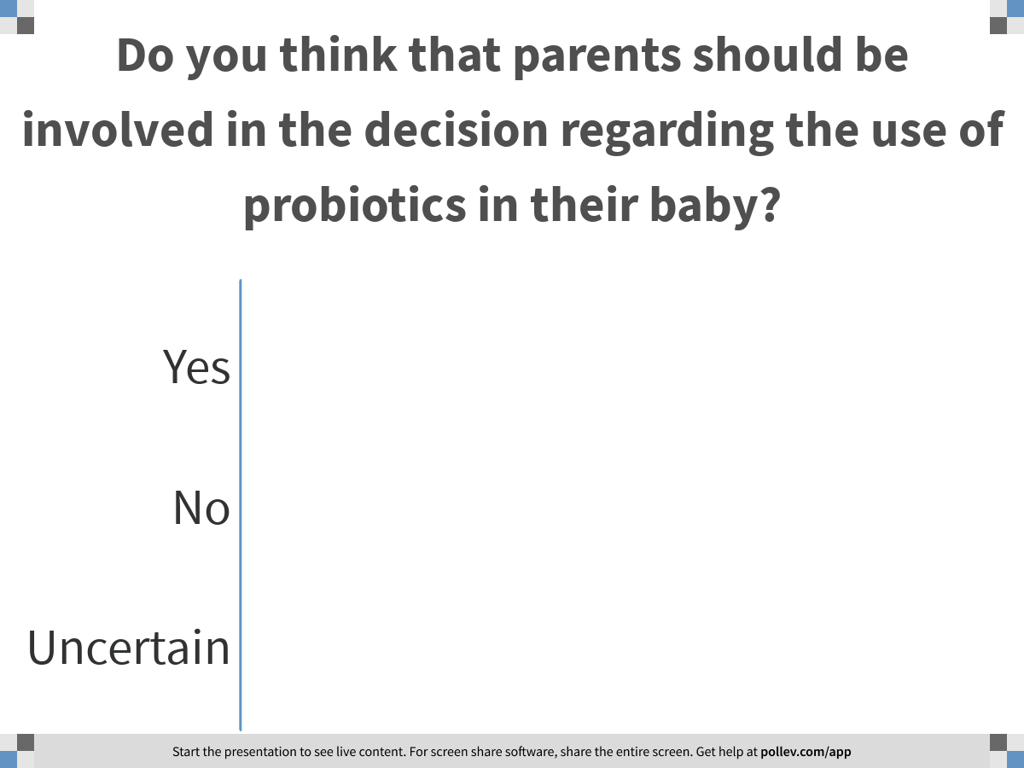
Notes:
Poll Title: Do you think that parents should be involved in the decision regarding the use of probiotics in their baby?
https://www.polleverywhere.com/multiple_choice_polls/LQFDMizgTDKudLvznAPQG

Slide 109
PROBIOTIC USE:
WHAT DO PARENTS THINK?
Information sheet helpful
Worried about use of live bacteria
Worried about unknown risks
Right to be informed
Given information and option
79%
10%
12%
96%
64%
Sesham and colleagues. Arch Dis Child Fetal Neonatal 2014

Slide 110
Probiotics for preterm infants
Do you think that further randomized controlled trials of probiotics compared to routine care are needed?
Yes
No
Uncertain

Slide 111
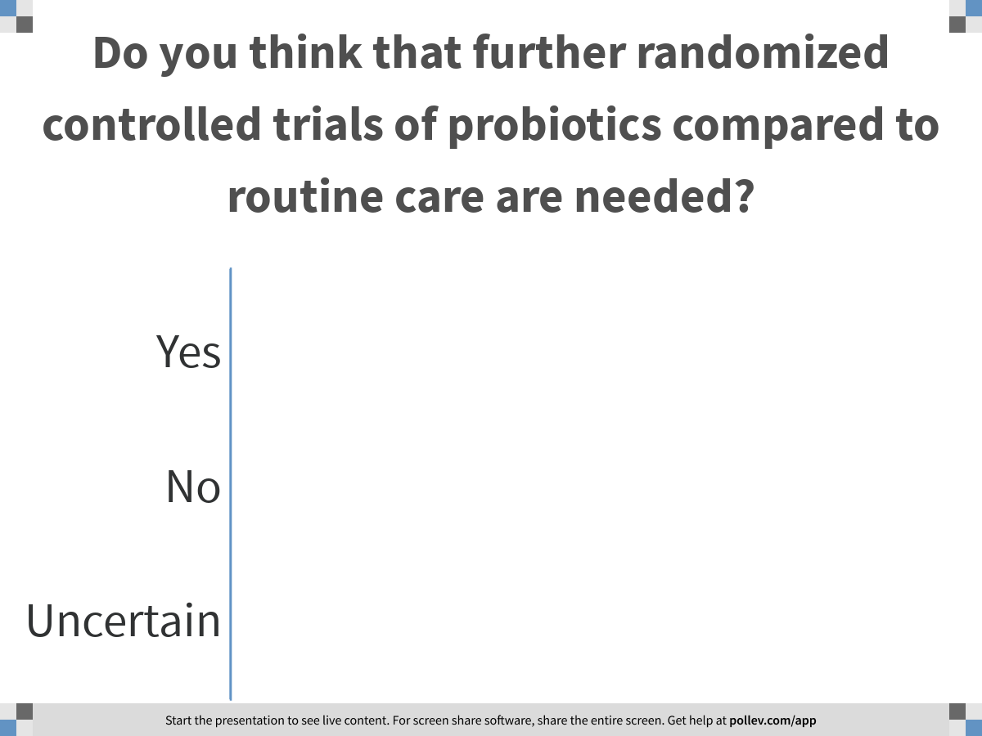
Notes:
Poll Title: Do you think that further randomized controlled trials of probiotics compared to routine care are needed?
https://www.polleverywhere.com/multiple_choice_polls/4N4pU9XTWyHJqnKm6oSTn

Slide 112
Probiotics for preterm infants
https://neonatalresearch.org/
“One thing I have difficulty understanding is the lack of clear guidance from either the American Academy of Pediatrics or the Canadian Paediatric Society regarding probiotic use in the preterm. Anything else that had been studied in 63 RCTs with over 15000 babies randomized showing a reduction in mortality, and a large reduction in serious NEC would surely by now have been the subject of a neonatal-specific position statement.”
Keith Barrington

Slide 113
PROBIOTICS FOR THE PREVENTION OF NECROTIZING ENTEROCOLITIS IN PRETERM INFANTS:
ARE MORE TRIALS NEEDED?
W. McGuire

Slide 114
Necrotizing Enterocolitis in VLBW Infants
VERMONT OXFORD NETWORK ANNUAL REPORTS 2000-2017

Slide 115
Probiotics for preterm infants
Probiotic supplementation (may) decrease the risk of necrotizing enterocolitis and (probably) improves survival.
Which product?
Need for further regulatory approval?
What is the role of families/parents
in furthering this research agenda?
In approving use in their baby?

Slide 116

Upcoming EBM Webinars
December 2nd 2020
Session 8: Optimizing nutrition for preterm infants
CME Contact Hours:
An email will be sent to all participants with links to post-webinar surveys. Upon completion of the survey, participants will receive their certificates. Surveys will be open for 2 weeks.
Questions: colleen.ovelman@uvm.edu

